Slide 1
Vector Graphics, Linear Algebra, and Geometry

Slide 2
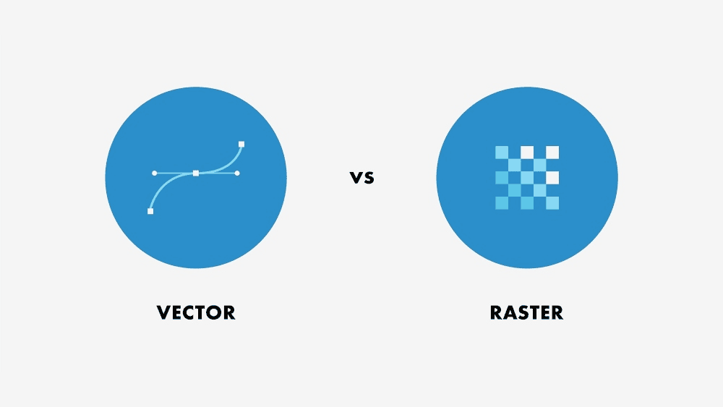
Recall: Types of Graphics
Vector
Raster
Driven by display commands, drawn as strokes
move(x, y), char(“A”), line(x, y)...
Based on geometric primitives
line, polygon, circle…
Common file format: SVG (scalable vector graphics)
Scalable resolution since defined by mathematical formulas
Ideal for calligraphy/typography, and geometric or highly structured images
Illustrator
Also known as a bitmap, or a fixed array of pixels each with some specified intensity, transparency and hue
No semantics, lowest form of representation
Fixed resolution
Common file formats: JPEG, BMP, GIF, TIFF
Note “jaggies” (aliasing errors) due to discrete sampling of continuous primitives
Ideal for natural images, TV, displays, laser printers
Photoshop, MS Paint

Slide 3
2D Vector Graphics

Slide 4

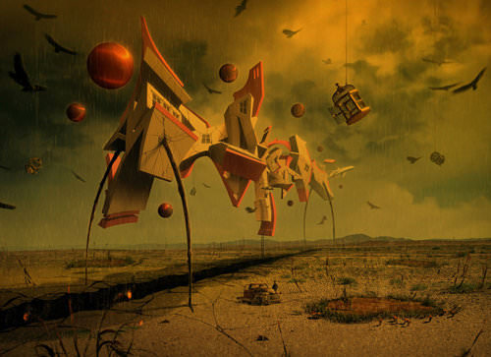

2D Vector Graphics
2D raster graphics are incredibly powerful. You can get pretty amazing results just editing pixel by pixel (e.g. in Photoshop).
Drifting Away by Erik Johansson
Memoir by Jeff Huang
(no, not that Jeff Huang) )
However, some imagery is hard to produce this way...

Slide 5
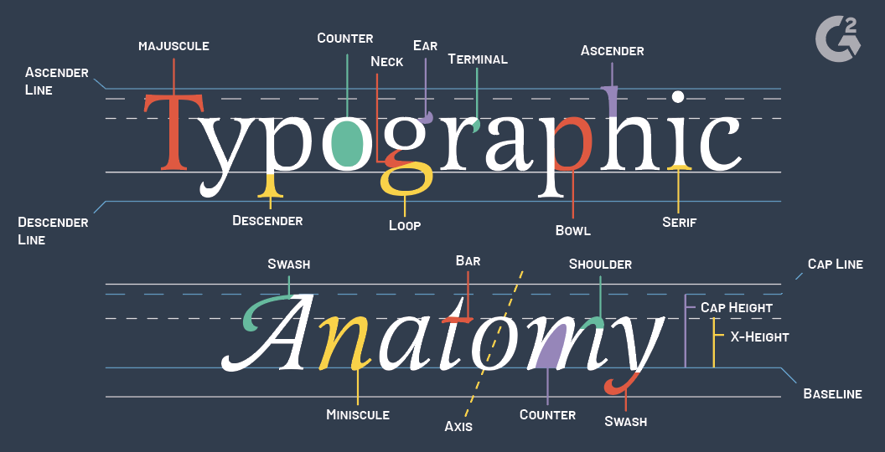
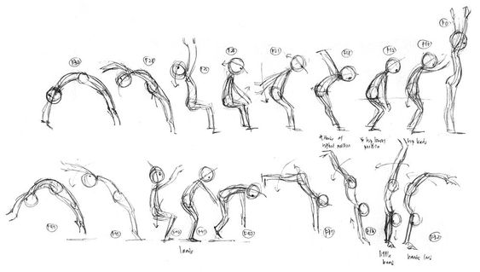
2D Vector Graphics
Typography and Graphic Design
Requires precise lines+curves
Animation
Would require to re-create slightly different images over and over again (how it used to be done!)
https://www.g2.com/articles/typography-terms
Hand-drawn key frames

Slide 6
2D Vector Graphics
In both cases, it’s much better to have some underlying representation of the objects behind the pixels
Typography + Graphic Design
Mathematical descriptions of smooth curves
Animation
Mathematical description of an object whose state (i.e. position, pose) changes over time
This is where the ‘vector’ in ‘vector graphics’ comes from: we’ll use vectors (a mathematical object) to describe the shapes of our objects

Slide 7
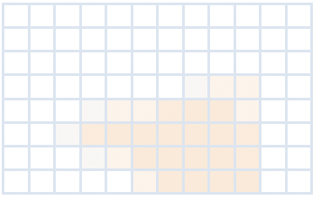
The Vector Graphics Pipeline
Define Object Geometry
Transform Objects
Define a “window” on the world
Render the window
Rendering is the process of going from vector representation of objects to raster image.
We can think of this as overlaying a grid of pixels on the the window we’ve defined on the world and ‘seeing what is under each pixel’.

Slide 8







Some graphics platforms that use this pipeline

Slide 9
Some graphics platforms that use this pipeline
We use these in this course

Slide 10
Coordinate Systems
As objects go through the vector graphics pipeline, they pass through, i.e. are transformed into, many coordinate systems.
Define Object Geometry
Transform Objects
Define a “window” on the world
Render the window
î_{C}
-1
ĵ_{O}
ĵ_{C}
ĵ_{o}
î_{O}
-1
1
Object (Local) Space
World Space
View (Camera) Space
Clip Space or Normalized Device Coordinates
ĵ_{W}
î_{o}
1
î_{W}
Note the scale, rotation, and translation transformations of the triangle from object space into world space

Slide 11
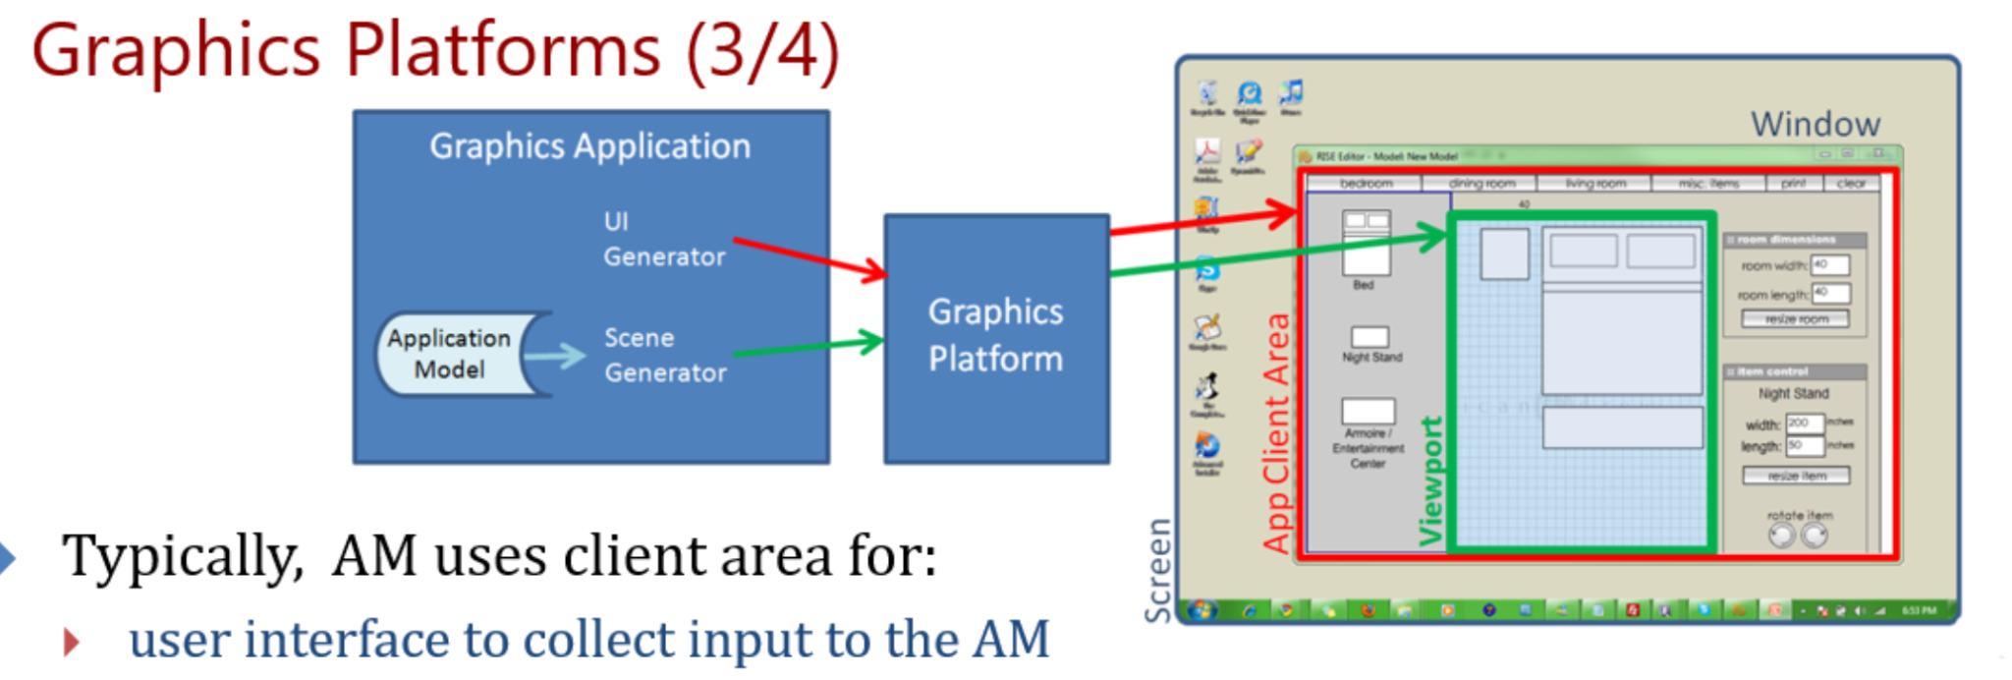
One more coordinate system: Screen Space
-1
If we look at this process in the context of an application that has some window within the OS window system, then we don’t have to render to the whole window: we can also choose to render into different sub-regions (called viewports) of our application window.
This ‘viewport transform’ takes us from ‘Normalized Device Coordinates’ to ‘Screen Space.’
Normalized Device Coords
-1
1
1
Screen Space

Slide 12
Why use multiple Coordinate Systems?
We use multiple spaces because
we want to be insulated from device coordinates
I don’t want to have to think about what exact pixel I’m drawing to
I want to be able to draw to any screen
we want to have the freedom to transform our objects and view the scene interactively == we want modularity (separate each thing we have control over into its own model/space)
we could move the camera to a new location, or mobilize it from a bird’s-eye perspective
we may want to place an object elsewhere in the scene
perhaps we want to modify the object geometry itself but keep the rest of the scene static

Slide 13
Vector Graphics Pipeline
Define Object Geometry
Transform Objects
Define a “window” on the world
Render the window
Let’s dig into the first couple stages of the pipeline a bit more…

Slide 14
Vector Graphics Pipeline
Define Object Geometry
Transform Objects
Define a “window” on the world
Render the window
Lots of different objects you might want to draw (squares, circles, curves, blobby blobs)
Application code will know about these shapes (mathematically), but graphics platform typically only knows about triangles

Slide 15
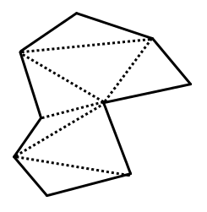
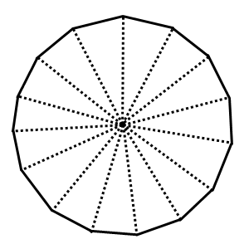
Why Triangles?
Simplest polygon that has area
We can decompose any shape into triangles
can even approximate points and lines (w/ very tiny or thin triangles)
Always planar and have a well-defined normal vector (in 3D…)
Graphics platform only has to know how to render triangles; as long as the application can convert objects to triangles, we’re good.
A complex polygon made of triangle primitives
An approximate circle made of triangle primitives

Slide 16
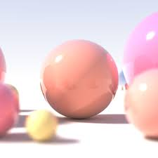
Vector Graphics Pipeline
Define Object Geometry
Transform Objects
Define a “window” on the world
Render the window
We’ll also see instances of geometry that is not represented as triangles
i.e. rendering a sphere without converting to triangles first
we’ll talk later about why/in what circumstances that might be a good idea
Ray-traced Sphere

Slide 17
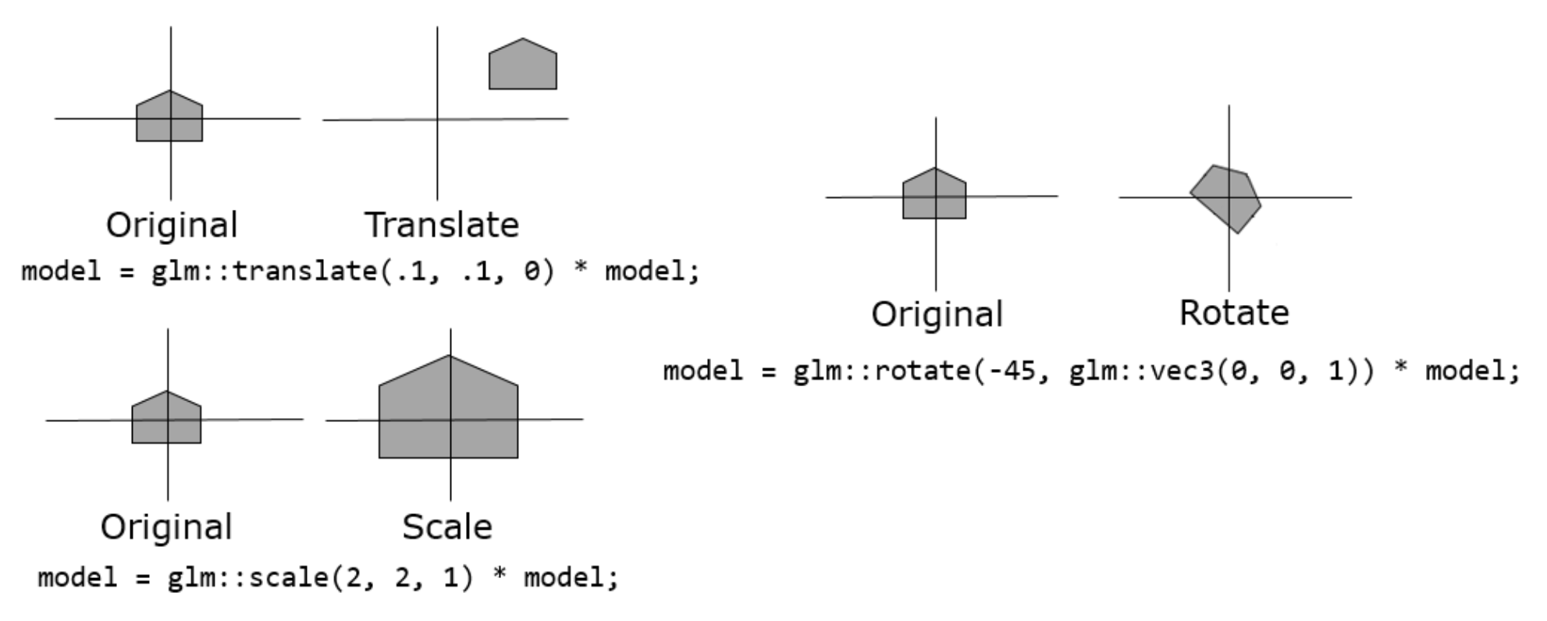
Vector Graphics Pipeline
Define Object Geometry
Transform Objects
Define a “window” on the world
Render the window
Standard types of transformations
Translate
Rotate
Scale
“Linear” because can be represented as linear functions, therefore can be represented as matrices (more on this soon)
Affine
Linear

Slide 18
From 2D to 3D
How does the vector graphics pipeline change as we go to 3D?
Define Object Geometry
Transform Objects
Define a “window” on the world
Render the window

Slide 19
From 2D to 3D
How does the vector graphics pipeline change as we go to 3D?
Define Object Geometry
Transform Objects
Define a “window” on the world
Render the window
k̂_{O}
ĵ_{O}
î_{O}
k̂_{O}
Object geometry is now 3D shapes (e.g. spheres, cuboids) instead of 2D shapes
ĵ_{O}
î_{O}

Slide 20
From 2D to 3D
How does the vector graphics pipeline change as we go to 3D?
Define Object Geometry
Transform Objects
Define a “window” on the world
Render the window
k̂_{O}
ĵ_{O}
k̂_{O}
î_{O}
ĵ_{O}
k̂_{O}
î_{O}
Transformations operate in 3D
k̂_{W}
k̂_{O}
ĵ_{O}
ĵ_{O}
ĵ_{W}
î_{O}
î_{O}
î_{W}

Slide 21

From 2D to 3D
How does the vector graphics pipeline change as we go to 3D?
Define Object Geometry
Transform Objects
Define a “window” on the world
Render the window
k̂_{O}
ĵ_{O}
k̂_{O}
î_{O}
ĵ_{O}
Defining a ‘window on the world’ turns into ‘placing a virtual camera in the world’
k̂_{O}
k̂_{W}
î_{O}
k̂_{O}
ĵ_{O}
ĵ_{O}
ĵ_{W}
î_{O}
î_{O}
î_{W}

Slide 22
From 2D to 3D
How does the vector graphics pipeline change as we go to 3D?
Define Object Geometry
Transform Objects
Define a “window” on the world
Render the window
k̂_{O}
ĵ_{O}
k̂_{O}
î_{O}
ĵ_{O}
k̂_{O}
k̂_{W}
î_{O}
k̂_{O}
ĵ_{O}
ĵ_{O}
ĵ_{W}
î_{O}
î_{O}
This step is more complex than in 2D
î_{W}

Slide 23
The Vector Graphics Pipeline
Define Object Geometry
Transform Objects
Define a “window” on the world
Render the window

Slide 24
The Vector Graphics Pipeline
Define Object Geometry
Transform Objects
Define a “window” on the world
Render the window

Slide 25
Defining Object Geometry
Geometry is described with combinations of points and directions in space
To talk about these kinds of quantities formally, we need to do a little bit of linear algebra

Slide 26
Linear Algebra

Slide 27
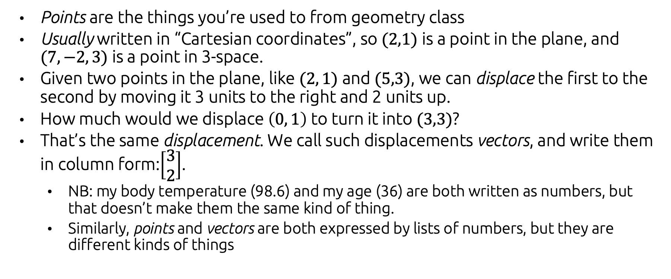
Points and Vectors (1)
Points are the things you’re used to from geometry class
Usually written in “Cartesian coordinates”, so $(2,1)$ is a point in the plane, and $(7, −2, 3)$ is a point in 3-space.
Given two points in the plane, like $(2, 1)$ and $(5,3)$, we can displace the first to the second by moving it 3 units to the right and 2 units up.
How much would we displace $\left(0, 1\right)$ to turn it into $(3,3)$?
That’s the same displacement. We call such displacements vectors, and write them in column form:$\left[\begin{aligned}3 \\ 2\end{aligned}\right]$.
NB: my body temperature (98.6) and my age (36) are both written as numbers, but that doesn’t make them the same kind of thing.
Similarly, points and vectors are both expressed by lists of numbers, but they are different kinds of things

Slide 28
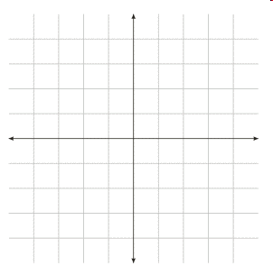
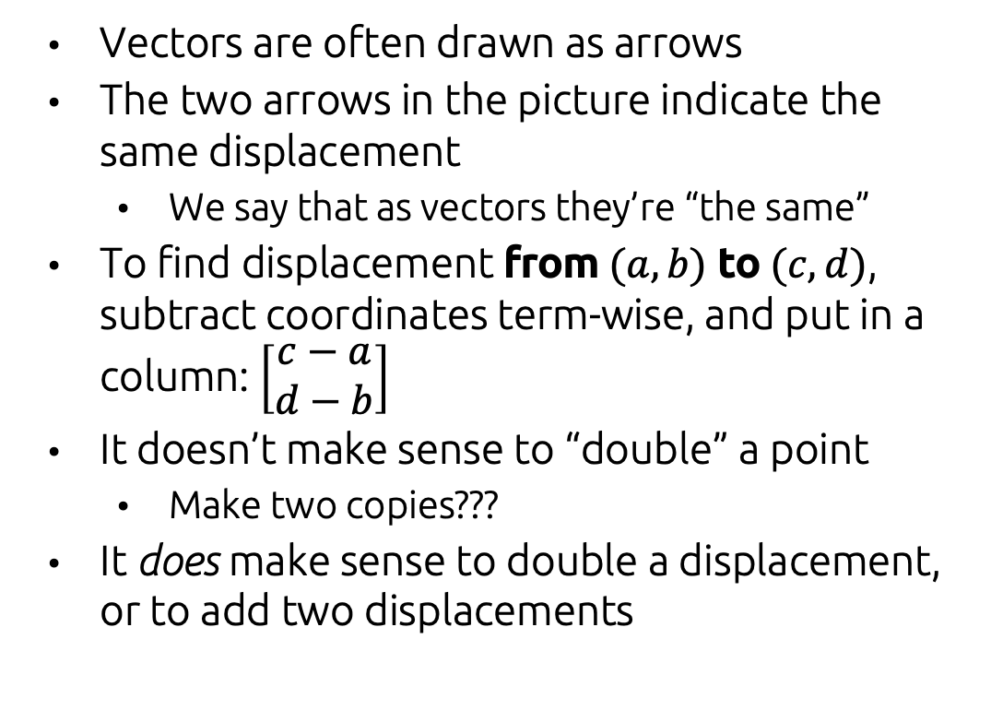
Points and Vectors (2)
Vectors are often drawn as arrows
The two arrows in the picture indicate the same displacement
We say that as vectors they’re “the same”
To find displacement from $(a,b)$ to $(c,d)$, subtract coordinates term-wise, and put in a column: $\left[\begin{aligned}c−a \\ d−b\end{aligned}\right]$
It doesn’t make sense to “double” a point
Make two copies???
It does make sense to double a displacement, or to add two displacements
(3,5)
(1,2)
(3,3)
(1,0)

Slide 29
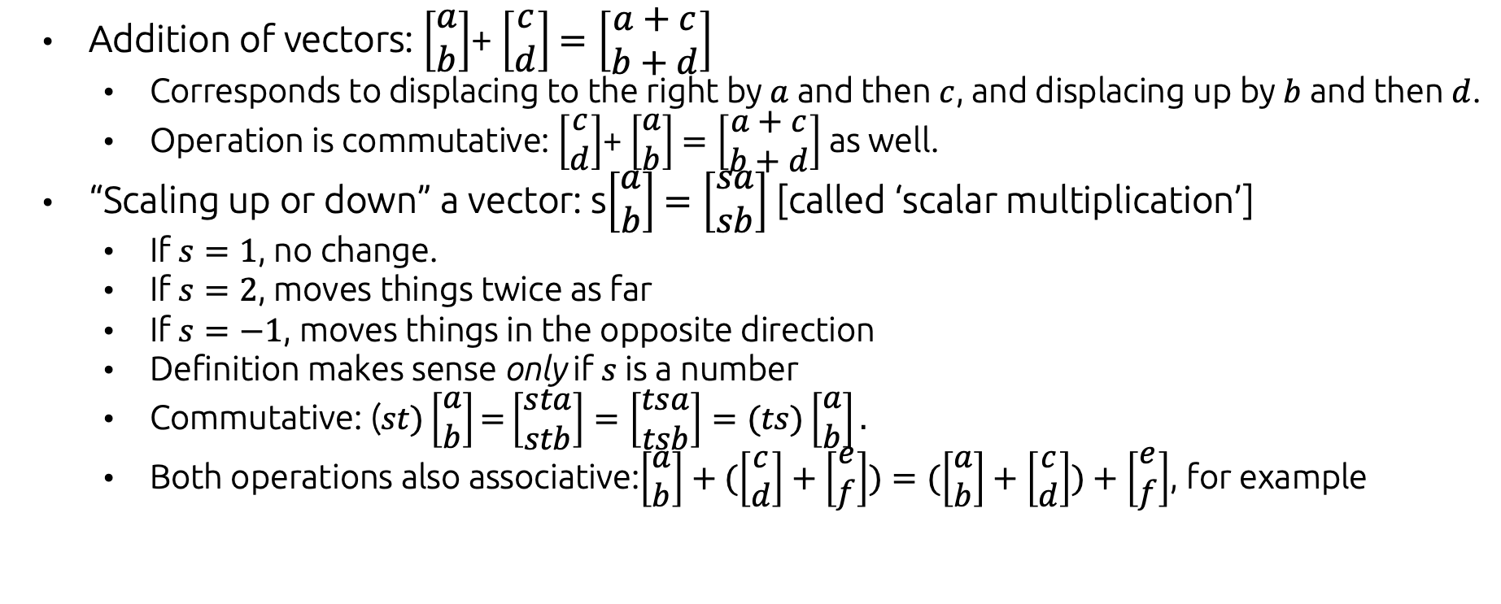
Operations on vectors
Addition of vectors: $\left[\begin{aligned}a \\ b\end{aligned}\right]$+ $\left[\begin{aligned}c \\ d\end{aligned}\right]$ $=\left[\begin{aligned}a+c \\ b+d\end{aligned}\right]$
Corresponds to displacing to the right by $a$ and then $c$, and displacing up by $b$ and then $d$.
Operation is commutative: $\left[\begin{aligned}c \\ d\end{aligned}\right]$+ $\left[\begin{aligned}a \\ b\end{aligned}\right]$ $=\left[\begin{aligned}a+c \\ b+d\end{aligned}\right]$as well.
“Scaling up or down” a vector: s$\left[\begin{aligned}a \\ b\end{aligned}\right]$ $=\left[\begin{aligned}sa \\ sb\end{aligned}\right]$ [called ‘scalar multiplication’]
If $s=1$, no change.
$\text{If} s=\text{2}\text{, }\text{moves} \text{things} \text{twice} \text{as} \text{far}$
If $s=−1$, moves things in the opposite direction
Definition makes sense only if $s$ is a number
Commutative: ($st)\left[\begin{aligned}a \\ b\end{aligned}\right]\text{=}\left[\begin{aligned}sta \\ stb\end{aligned}\right]=\left[\begin{aligned}tsa \\ tsb\end{aligned}\right]=(ts)\left[\begin{aligned}a \\ b\end{aligned}\right].$
Both operations also associative:$\left[\begin{aligned}a \\ b\end{aligned}\right]+(\left[\begin{aligned}c \\ d\end{aligned}\right]+\left[\begin{aligned}e \\ f\end{aligned}\right])=(\left[\begin{aligned}a \\ b\end{aligned}\right]+\left[\begin{aligned}c \\ d\end{aligned}\right])+\left[\begin{aligned}e \\ f\end{aligned}\right]$, for example

Slide 30
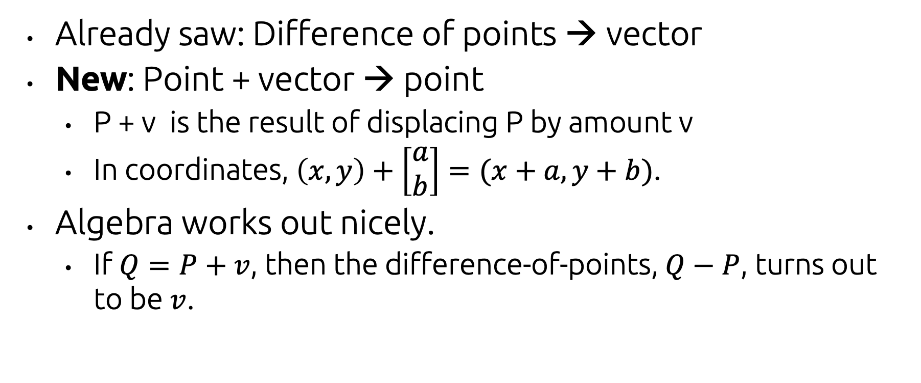
Mixing points and vectors
Already saw: Difference of points → vector
New: Point + vector → point
P + v is the result of displacing P by amount v
In coordinates, $\left(x, y\right)+\left[\begin{aligned}a \\ b\end{aligned}\right]=(x+a, y+b)$.
Algebra works out nicely.
If $Q=P+v$, then the difference-of-points, $Q−P$, turns out to be $v$.

Slide 31
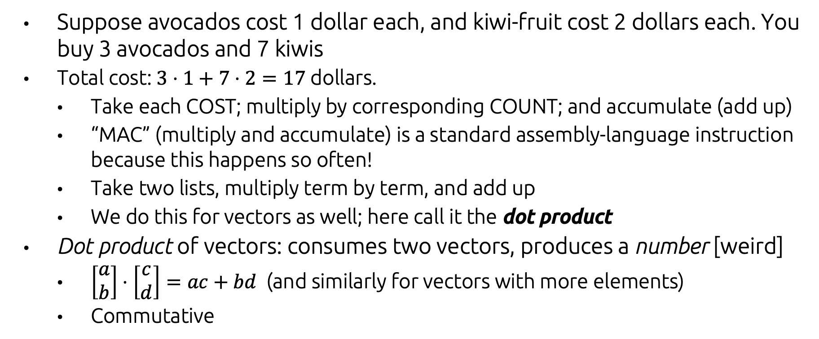
Dot product of vectors
Suppose avocados cost 1 dollar each, and kiwi-fruit cost 2 dollars each. You buy 3 avocados and 7 kiwis
Total cost: $3⋅1+7⋅2=17$ dollars.
Take each COST; multiply by corresponding COUNT; and accumulate (add up)
“MAC” (multiply and accumulate) is a standard assembly-language instruction because this happens so often!
Take two lists, multiply term by term, and add up
We do this for vectors as well; here call it the dot product
Dot product of vectors: consumes two vectors, produces a number [weird]
$\left[\begin{aligned}a \\ b\end{aligned}\right]⋅\left[\begin{aligned}c \\ d\end{aligned}\right]=ac+bd$ (and similarly for vectors with more elements)
Commutative

Slide 32
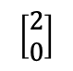
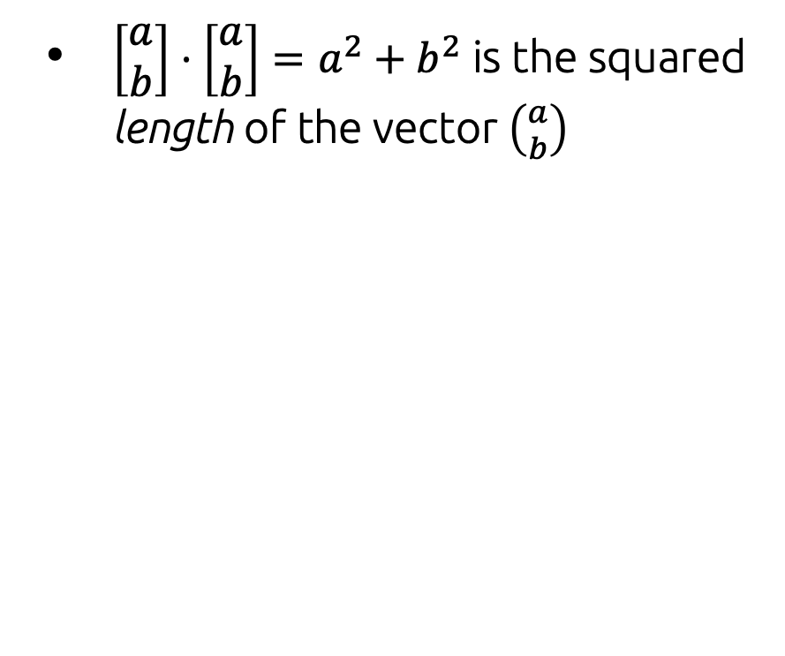
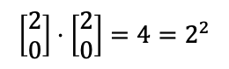
Geometric interpretation of dot product
$\left[\begin{aligned}a \\ b\end{aligned}\right]⋅\left[\begin{aligned}a \\ b\end{aligned}\right]=a^{2}+b^{2}$ is the squared length of the vector $\left({a \atop b}\right)$
Obviously correct for axis-aligned vectors:
$$\left[\begin{aligned}2 \\ 0\end{aligned}\right]$$
$$\left[\begin{aligned}2 \\ 0\end{aligned}\right]⋅\left[\begin{aligned}2 \\ 0\end{aligned}\right]=4=2^{2}$$

Slide 33
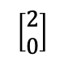
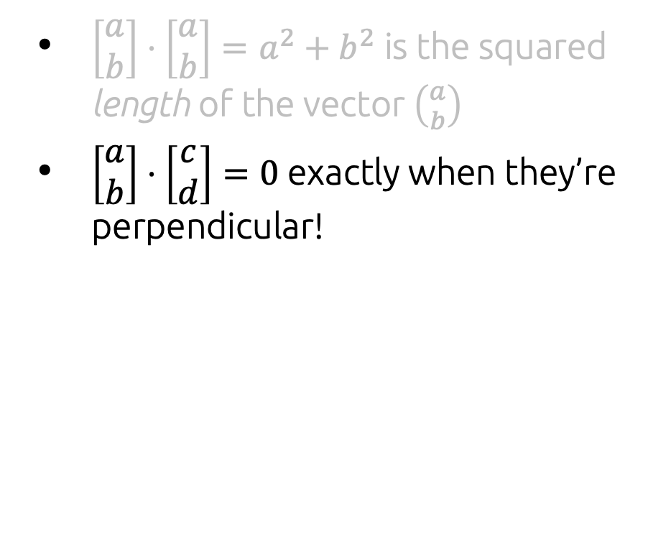
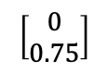
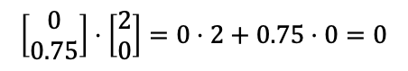
Geometric interpretation of dot product
$\left[\begin{aligned}a \\ b\end{aligned}\right]⋅\left[\begin{aligned}a \\ b\end{aligned}\right]=a^{2}+b^{2}$ is the squared length of the vector $\left({a \atop b}\right)$
$\left[\begin{aligned}a \\ b\end{aligned}\right]⋅\left[\begin{aligned}c \\ d\end{aligned}\right]=0$ exactly when they’re perpendicular!
Again, obviously correct for axis-aligned vectors:
$$\left[\begin{aligned}0 \\ 0.75\end{aligned}\right]$$
$$\left[\begin{aligned}2 \\ 0\end{aligned}\right]$$
$$\left[\begin{aligned}0 \\ 0.75\end{aligned}\right]⋅\left[\begin{aligned}2 \\ 0\end{aligned}\right]=0⋅2+0.75⋅0=0$$

Slide 34
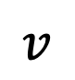
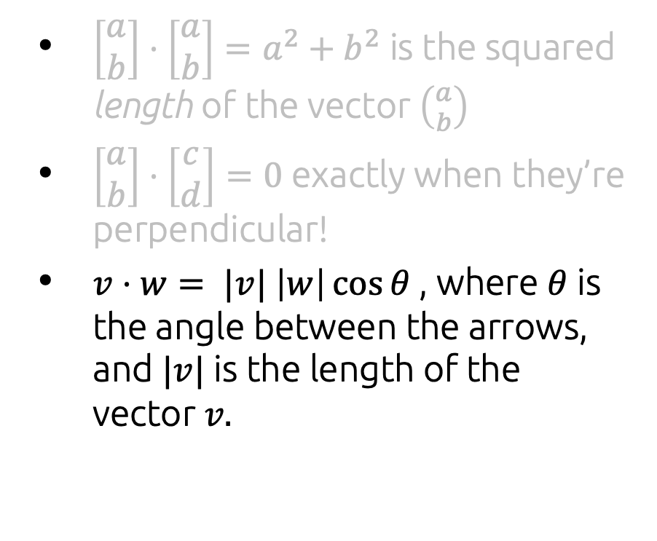


Geometric interpretation of dot product
$\left[\begin{aligned}a \\ b\end{aligned}\right]⋅\left[\begin{aligned}a \\ b\end{aligned}\right]=a^{2}+b^{2}$ is the squared length of the vector $\left({a \atop b}\right)$
$\left[\begin{aligned}a \\ b\end{aligned}\right]⋅\left[\begin{aligned}c \\ d\end{aligned}\right]=0$ exactly when they’re perpendicular!
$v⋅w= |v| \left|w\right|\cos{θ}$, where $θ$ is the angle between the arrows, and $|v|$ is the length of the vector $v.$
$$v$$
$$θ$$
$$w$$

Slide 35
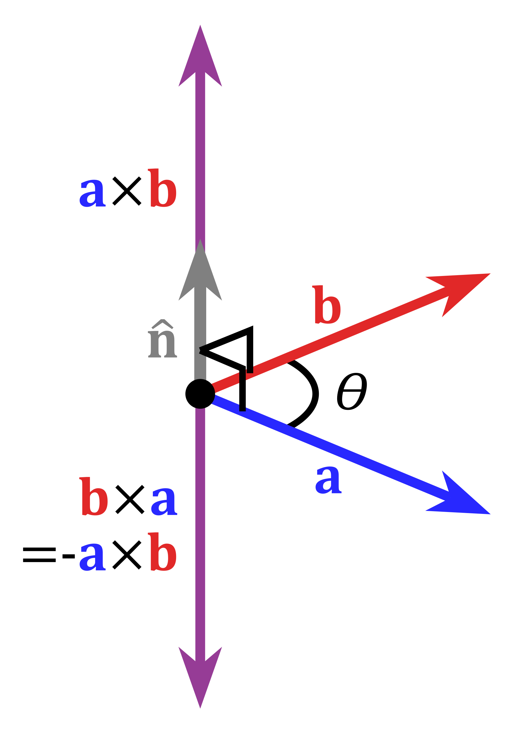
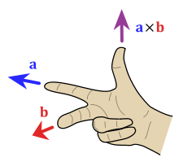
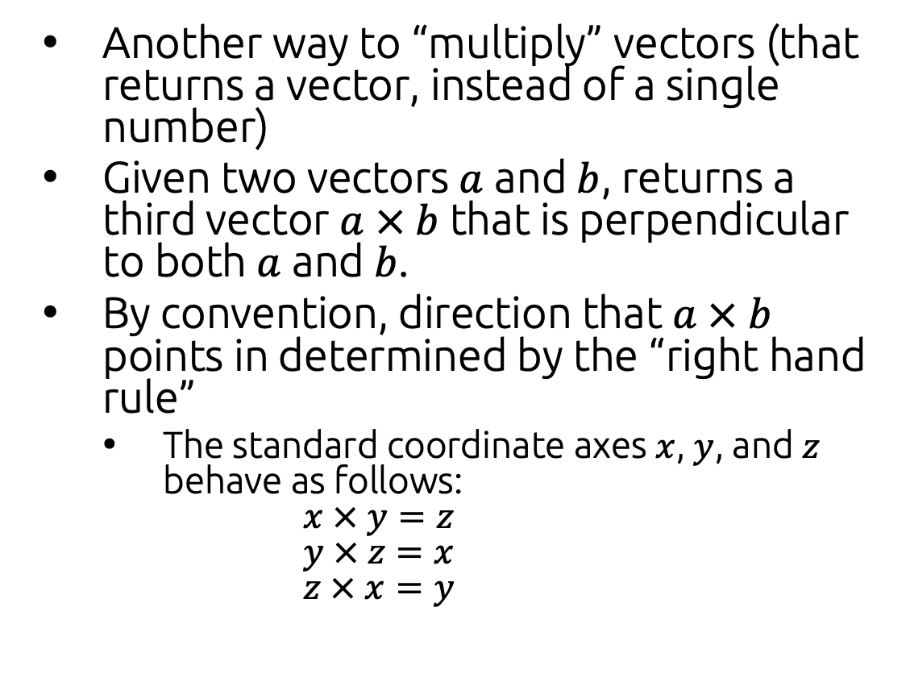
Cross product of vectors
Another way to “multiply” vectors (that returns a vector, instead of a single number)
Given two vectors $a$ and $b$, returns a third vector $a × b$that is perpendicular to both $a$and $b$.
By convention, direction that $a × b$ points in determined by the “right hand rule”
The standard coordinate axes $x$, $y$, and $z$ behave as follows: $x × y=z$ $y × z=x$ $z × x=y$
[Wikipedia]

Slide 36
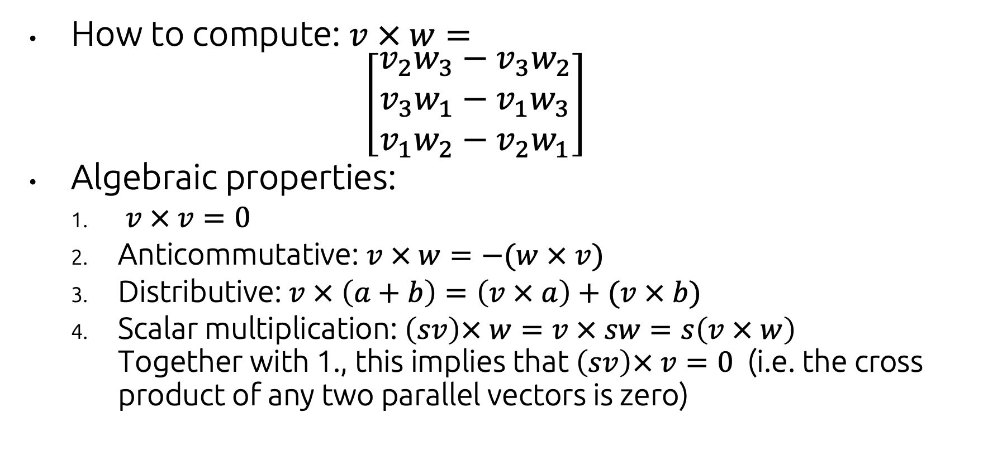
Cross product of vectors
How to compute: $v × w=$ $\left[\begin{matrix}v_{2}w_{3}−v_{3}w_{2} \\ v_{3}w_{1}−v_{1}w_{3} \\ v_{1}w_{2}−v_{2}w_{1}\end{matrix}\right]$
Algebraic properties:
$v × v=0$
Anticommutative: $v × w=−(w × v)$
Distributive: $v × \left(a+b\right)=\left(v × a\right)+(v × b)$
Scalar multiplication: $\left(sv\right)× w=v × sw=s\left(v × w\right)$ Together with 1., this implies that $\left(sv\right)× v=0$ (i.e. the cross product of any two parallel vectors is zero)

Slide 37
Cross product of vectors
How to compute: $v × w=$ $\left[\begin{matrix}v_{2}w_{3}−v_{3}w_{2} \\ v_{3}w_{1}−v_{1}w_{3} \\ v_{1}w_{2}−v_{2}w_{1}\end{matrix}\right]$
Algebraic properties:
$v × v=0$
Anticommutative: $v × w=−(w × v)$
Distributive: $v × \left(a+b\right)=\left(v × a\right)+(v × b)$
Scalar multiplication: $\left(sv\right)× w=v × sw=s\left(v × w\right)$ Together with 1., this implies that $\left(sv\right)× v=0$ (i.e. the cross product of any two parallel vectors is zero)

Slide 38
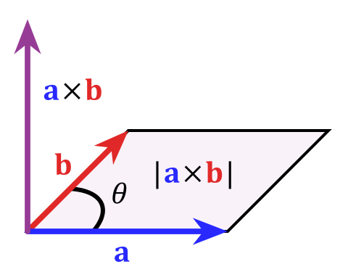
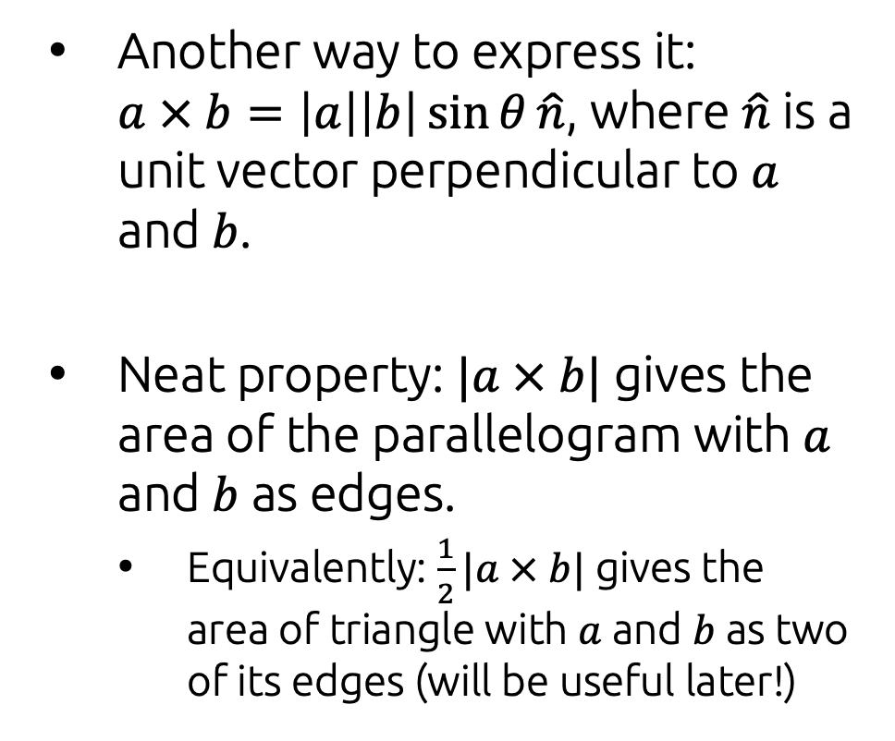
Geometric interpretation of cross product
Another way to express it: $a × b=\left|a\right|\left|b\right|\sin{θ}\hat{n}$, where $\hat{n}$ is a unit vector perpendicular to $a$ and $b$.
Neat property: $|a × b|$ gives the area of the parallelogram with $a$ and $b$ as edges.
Equivalently: $\frac{1}{2}|a × b|$ gives the area of triangle with $a$ and $b$ as two of its edges (will be useful later!)

Slide 39

Vector math in code: GLM
Throughout the course, we’ll use the C++ library GLM to perform numerical linear algebra.
https://github.com/g-truc/glm

Slide 40
GLM: Creating vectors
#include <glm/glm.hpp>
// Construct a 3D vector
glm::vec3 v1 = glm::vec3( 1.0f, 2.0f, 3.0f);
// Construct a 3D vector of all zeros
glm::vec3 v2 = glm::vec3(0.0f);
// Construct a 4D vector [0, 0, 0, 1]
glm::vec4 v3 = glm::vec4( glm::vec3( 0.0f ), 1.0f );

Slide 41
GLM: Dot and cross products
// Create two vectors
glm::vec3 v1 = glm::vec3( 1.0f, 0.0f, 0.0f);
glm::vec3 v1 = glm::vec3( 0.0f, 1.0f, 0.0f);
// Dot product
float d = glm::dot(v1, v2); // what is d?
// d = 0
// Cross product
glm::vec3 v3 = glm::cross(v1, v2); // what is v3?
// v3 = [0, 0, 1]

Slide 42
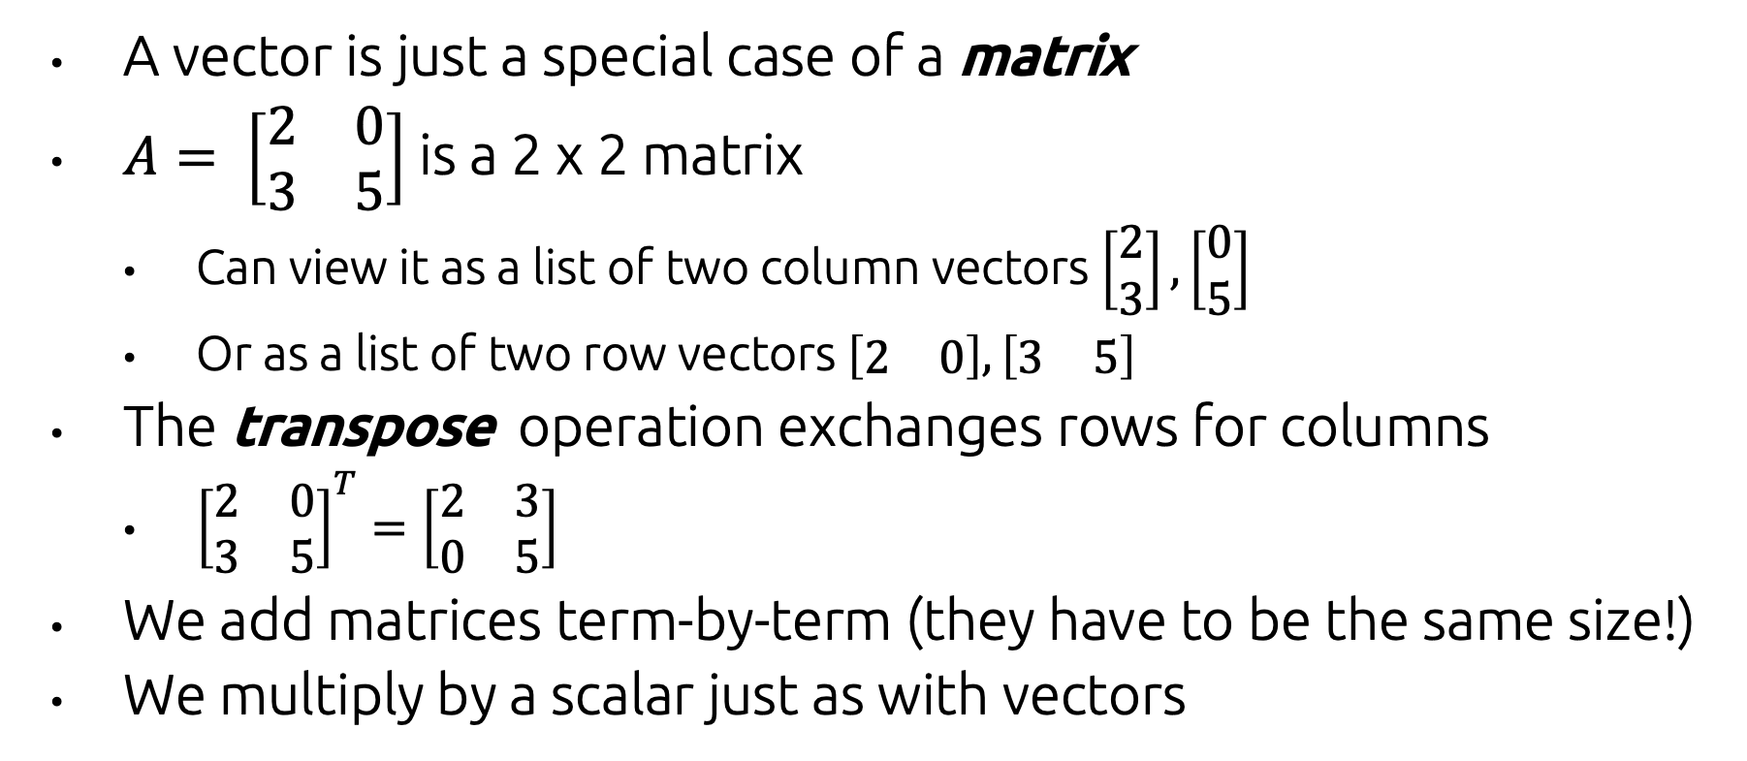
Matrices
A vector is just a special case of a matrix
$A= \left[\begin{matrix}2 & 0 \\ 3 & 5\end{matrix}\right]$ is a 2 x 2 matrix
Can view it as a list of two column vectors $\left[\begin{aligned}2 \\ 3\end{aligned}\right],\left[\begin{aligned}0 \\ 5\end{aligned}\right]$
Or as a list of two row vectors$\left[\begin{matrix}2 & 0\end{matrix}\right], \left[\begin{matrix}3 & 5\end{matrix}\right]$
The transpose operation exchanges rows for columns
${\left[\begin{matrix}2 & 0 \\ 3 & 5\end{matrix}\right]}^{T}=\left[\begin{matrix}2 & 3 \\ 0 & 5\end{matrix}\right]$
We add matrices term-by-term (they have to be the same size!)
We multiply by a scalar just as with vectors

Slide 43
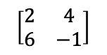
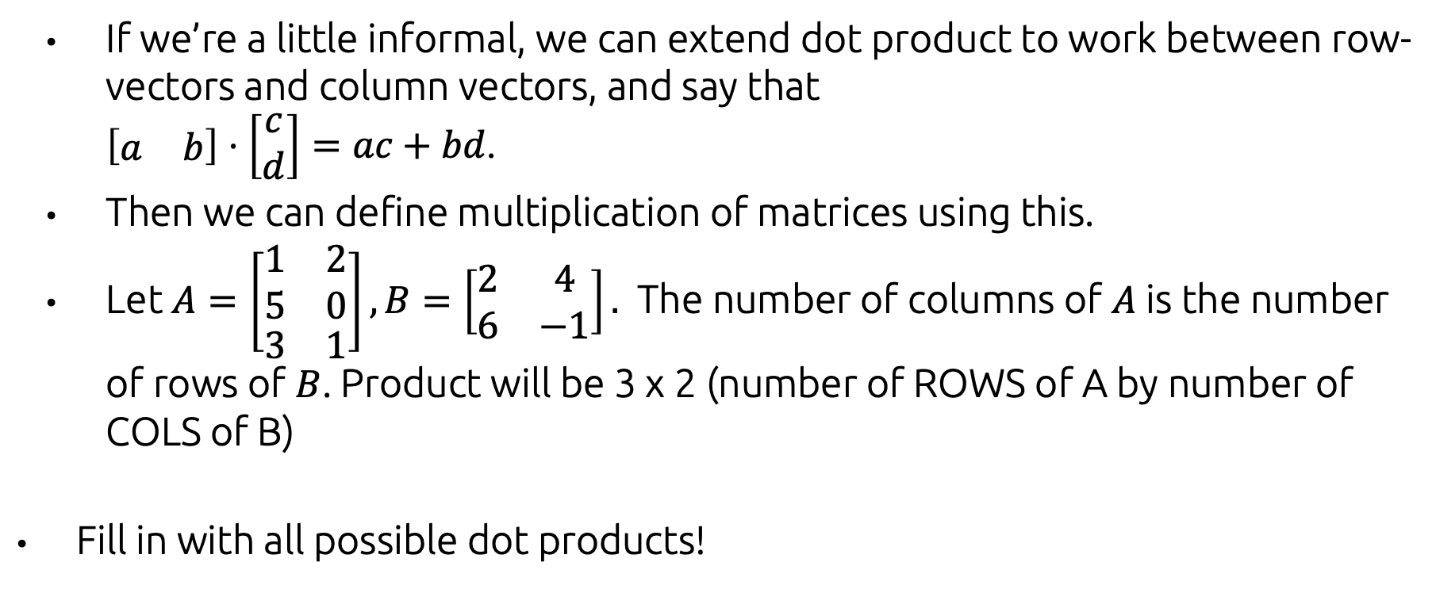
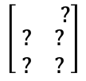

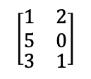
Matrix Product
If we’re a little informal, we can extend dot product to work between row-vectors and column vectors, and say that $\left[\begin{matrix}a & b\end{matrix}\right]⋅\left[\begin{aligned}c \\ d\end{aligned}\right]=ac+bd$.
Then we can define multiplication of matrices using this.
Let $A=\left[\begin{aligned}\begin{matrix}1 & 2 \\ 5 & 0\end{matrix} \\ \begin{matrix}3 & 1\end{matrix}\end{aligned}\right], B=\left[\begin{matrix}2 & 4 \\ 6 & −1\end{matrix}\right].$ The number of columns of $A$ is the number of rows of $B$. Product will be 3 x 2 (number of ROWS of A by number of COLS of B)
Fill in with all possible dot products!
$$\left[\begin{matrix}2 & 4 \\ 6 & −1\end{matrix}\right]$$
$$\left[\begin{aligned}\begin{matrix}1 & 2 \\ 5 & 0\end{matrix} \\ \begin{matrix}3 & 1\end{matrix}\end{aligned}\right]$$
$$z$$
$$\left[\begin{aligned}\begin{matrix} & ?\end{matrix} \\ \begin{matrix}? & ? \\ ? & ?\end{matrix}\end{aligned}\right]$$

Slide 44
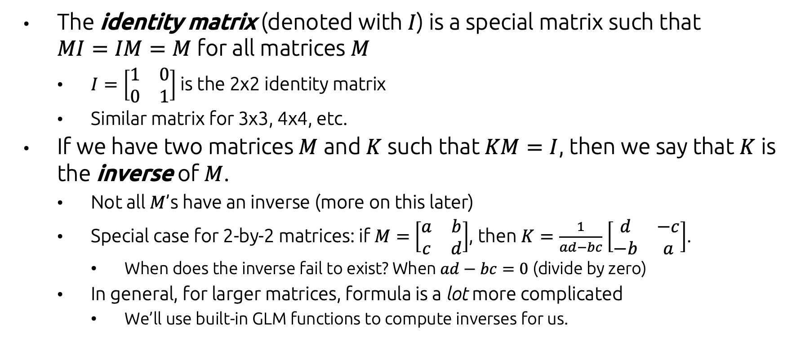
Matrix Inverse
The identity matrix (denoted with $I$) is a special matrix such that $MI=IM=M$ for all matrices $M$
$I=\left[\begin{matrix}1 & 0 \\ 0 & 1\end{matrix}\right]$ is the 2x2 identity matrix
Similar matrix for 3x3, 4x4, etc.
If we have two matrices $M$ and $K$ such that $KM=I$, then we say that $K$ is the inverse of $M$.
Not all $M$’s have an inverse (more on this later)
Special case for 2-by-2 matrices: if $M=$ $\left[\begin{matrix}a & b \\ c & d\end{matrix}\right]$, then $K=\frac{1}{ad−bc}$ $\left[\begin{matrix}d & −c \\ −b & a\end{matrix}\right]$.
When does the inverse fail to exist? When $ad−bc=0$ (divide by zero)
In general, for larger matrices, formula is a lot more complicated
We’ll use built-in GLM functions to compute inverses for us.

Slide 45
GLM: Matrices
// Create a 3x3 identity matrix
glm::mat3 I = glm::mat3( 1.0);
// Create a 3x3 matrix and set its columns
glm::mat3 M;
M[0] = glm::vec3(1.0f, 2.0f, 3.0f);
M[1] = glm::vec3(4.0f, 5.0f, 6.0f);
M[2] = glm::vec3(1.0f, 2.0f, 3.0f);
// Multiply M by I
M = M * I; // * operator is overloaded
// Compute the transpose and the inverse of M
glm::mat3 Mt = glm::transpose(M);
glm::mat3 Mi = glm::inverse(M);

Slide 46
Wrapping up (for now)
This is enough of a linear algebra foundation for us for the course.
Later, we’ll dig more into what matrix multiplication means geometrically, and how we can use that knowledge to our advantage...

Slide 47
Defining Object Geometry
Geometry is described with combinations of points and directions in space
...specifically, in most graphics packages, geometry is specified as collections of triangles

Slide 48
Triangles & Triangle Meshes

Slide 49
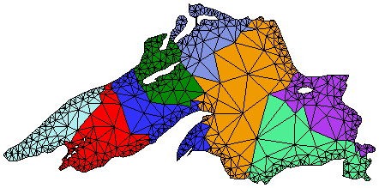
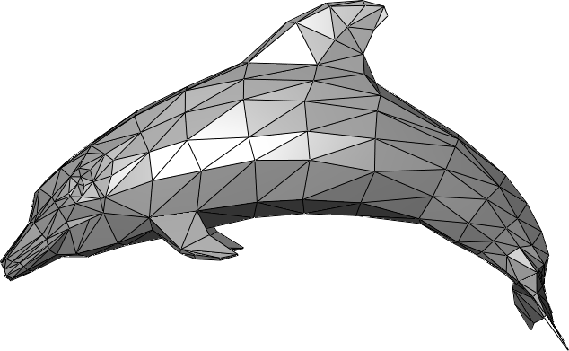
Representing Geometry w/ Triangles
Recall: why we use triangles
Simplest possible polygon that has 2D area (more formally: a 2-simplex)
Any 2D shape can be broken into a set of 2D triangles
Any 3D surface can be broken into a set of 3D triangles
We call this process tessellation; a shape which has been tessellated into triangles is a triangle mesh.
Provides nice abstraction (which we like as computer scientists!): our graphics libraries only have to know how to draw triangles.
https://www.cs.cmu.edu/~quake/triangle.html
[Wikipedia]

Slide 50
A Data Structure for 2D Triangle Meshes
// A triangle is defined by its three vertices
struct Triangle { glm::vec2 v[3]; }
// A triangle mesh is just a list of triangles
struct TriMesh { std::vector<Triangle> tris; }
Q: Downsides to this representation?

Slide 51
A Data Structure for 2D Triangle Meshes
// A triangle is defined by its three vertices
struct Triangle { glm::vec2 v[3]; }
// A triangle mesh is just a list of triangles
struct TriMesh { std::vector<Triangle> tris; }
Q: Downsides to this representation?
A1: Duplicate vertices → wasted memory
A2: Duplicate vertices → mesh becomes ‘disconnected’ if vertices are moved

Slide 52
A Better Data Structure for Triangle Meshes
// A triangle is defined by three indices
struct Triangle { int v[3]; }
// A triangle mesh is a list of vertices + a
// list of triangles which index those vertices
struct TriMesh {
std::vector<glm::vec2> verts;
std::vector<Triangle> faces;
}

Slide 53
A Better Data Structure for Triangle Meshes
// A triangle is defined by three indices
struct Triangle { int v[3]; }
// A triangle mesh is a list of vertices + a
// list of triangles which index those vertices
struct TriMesh {
std::vector<glm::vec3> verts;
std::vector<Triangle> faces;
}
Works equally well for 3D triangle meshes

Slide 54
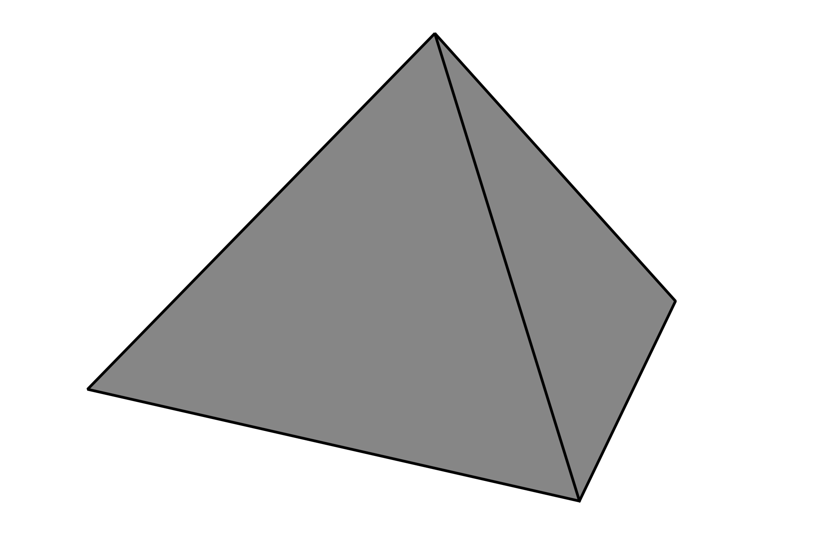
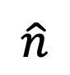
Triangles in 3D: Normal Vectors
In 2D, every triangle is ‘facing’ in the same direction (out of the plane)
In 3D, triangles can be facing in any direction
The direction a 3D triangle is facing can be quantified via its normal vector : the vector perpendicular to the plane of the triangle
What’s the normal used for?
Direction the normal faces determines the front (outside) vs. back (inside) of the triangle (renderers can skip ‘back-facing’ triangles)
Simulating interaction of light with surface (more on this later)
2D
3D
$$\hat{n}$$

Slide 55
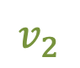
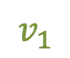
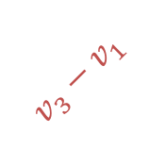
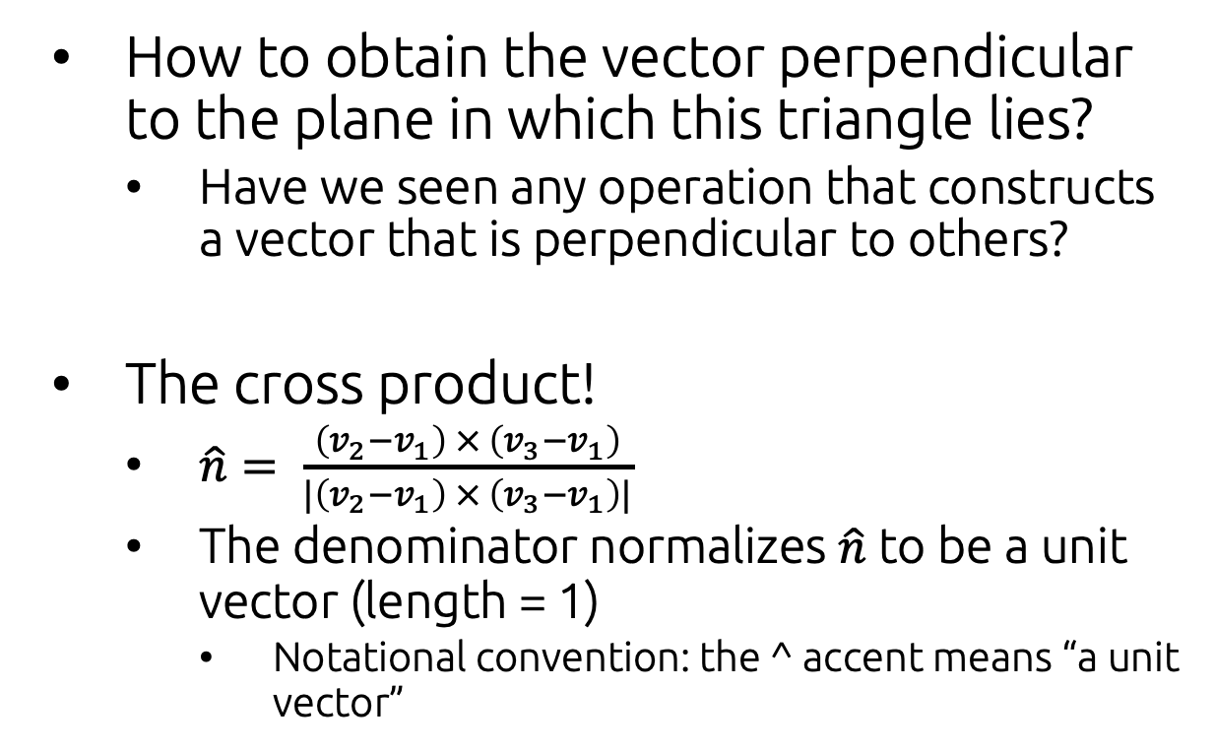
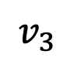
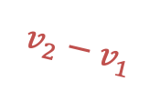
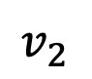

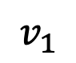
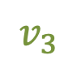
Computing Triangle Normals
$$v_{3}$$
How to obtain the vector perpendicular to the plane in which this triangle lies?
Have we seen any operation that constructs a vector that is perpendicular to others?
The cross product!
$\hat{n}= \frac{\left(v_{2}−v_{1}\right) × \left(v_{3}−v_{1}\right)}{|\left(v_{2}−v_{1}\right) × \left(v_{3}−v_{1}\right)|}$
The denominator normalizes $\hat{n}$ to be a unit vector (length = 1)
Notational convention: the ^ accent means “a unit vector”
$$v_{1}$$
$$v_{2}$$
$$v_{3}$$
$$\hat{n}$$
$${v_{3}−v}_{1}$$
$$v_{1}$$
$${v_{2}−v}_{1}$$
$$v_{2}$$

Slide 56







Computing Vertex Normals
$${\hat{n}}_{v}$$
We can define normals on each vertex by interpolating from its neighboring triangles
Interpolation weights $w_{i}$ are proportional to the area of triangle $i$
...which is just ½ the length of the normal vector before normalization!
$${\hat{n}}_{3}$$
$$v$$
$${\hat{n}}_{1}$$
$${\hat{n}}_{2}$$
$${\hat{n}}_{v}=\sum_{i}{w_{i}⋅{\hat{n}}_{i}}$$

Slide 57

Computing Vertex Normals
Why do we care about computing normals on vertices?
As we’ll see later, it’ll make the difference between rendering ‘smooth’ vs. ‘faceted’ surfaces

Slide 58



Mesh File Formats
How do we store triangle meshes on disk?
Each 3D software package has its own file format
3D Studio MAX: 3DS
Maya: MA, MB
Blender: BLEN
...
There are also open interchange formats for moving data between applications (e.g. create geometry in one piece of software, then render it in another)
DAE (Collada)
PLY
STL
OFF
OBJ

Slide 59
Mesh File Formats
How do we store triangle meshes on disk?
Each 3D software package has its own file format
3D Studio MAX: 3DS
Maya: MA, MB
Blender: BLEN
...
There are also open interchange formats for moving data between applications (e.g. create geometry in one piece of software, then render it in another)
DAE (Collada)
PLY
STL
OFF
OBJ
This is probably the simplest and most common

Slide 60
The OBJ File Format
Plain text
Defines lists of
Vertex positions
Vertex normals
Texture coordinates (we’ll talk more about these later)
Polygonal faces (usually triangles)
Very simple to parse!
Example OBJ file (describes a two-triangle rectangle):
# positions
v 0 0 0
v 1 0 0
v 0 1 0
v 1 1 0
# normals
vn 0 0 1
# faces (position index//normal index)
f 1//1 2//1 3//1
f 3//1 2//1 4//1

Slide 61






Exercise!
Write down an OBJ file that specifies this tetrahedron
Don’t worry about normals (just vertex positions and face indices)
$$z$$
Height = 1
$$y$$
Side length = 1
Side length = 1
(0,0,0)
$$x$$
Side length = 1
A fact you may find useful: $\tan{{30}^{°}=1/\sqrt{3}}$

Slide 62








Solution
Vertex positions for the base face:
(0.5, $\frac{\sqrt{3}}{2}$,0)
$${30}^{°}$$
1
1
$$z$$
Height = 1
$$y$$
$$y$$
Side length = 1
Side length = 1
$${60}^{°}$$
(0,0,0)
$$x$$
Side length = 1
(0,0,0)
0.5
0.5
(1,0,0)
$$\tan{{30}^{°}}=\frac{0.5}{y} →y=0.5/\tan{{30}^{°} →y=\frac{\sqrt{3}}{2} }$$

Slide 63




Solution
Top vertex position
Z coord = 1
X,Y cords: average of 3 base vertex X,Y coords
(0.5, $\frac{\sqrt{3}}{2}$,0)
$$(x,y)$$
$$z$$
Height = 1
(0,0,0)
(1,0,0)
$$y$$
Side length = 1
Side length = 1
$$\left(x,y\right)=\frac{1}{3}\left(0,0\right)+\frac{1}{3}\left(1,0\right)+\frac{1}{3}\left(0.5,\frac{\sqrt{3}}{2}\right)=\left(0.5,\frac{\sqrt{3}}{6}\right)$$
(0,0,0)
$$x$$
Side length = 1

Slide 64


Solution
All vertex positions
(0.5, $\frac{\sqrt{3}}{6}$,1)
(0.5, $\frac{\sqrt{3}}{2}$,0)
(0,0,0)
(1,0,0)

Slide 65


Solution
(0.5, $\frac{\sqrt{3}}{6}$,1)
# positions
v 0 0 0
v 1 0 0
v 0.5 0.866 0
v 0.5 0.288 1
# faces
f 1 3 2
f 1 2 4
f 1 4 3
f 2 3 4
(0.5, $\frac{\sqrt{3}}{2}$,0)
(0,0,0)
(1,0,0)
Face vertices ordered counter-clockwise (when faces viewed from outside) to give a consistent and correct normal orientation

Slide 66
Acknowledgments
These slides were created by:
Daniel Ritchie
Megan Gessner
Andy van Dam
John Hughes
...and many past CSCI 1230 TAs!

